Slide 1
Risk Management Workshop
CJUSD

Slide 2
Workers Compensation
Process

Slide 3
WHO SHOULD YOU CALL?
WC Claims –Alpha Split A-L
(by employee last name)
WC Claims –Alpha Split M-Z
(by employee last name)
TBD
Risk Management Specialist
P:909-580-6614
C:909-213-7571
Jessica Jimenez
Risk Management Specialist
P:909-580-6612
C:909-554-0223
jessica_jimenez@cjusd.net

Slide 4
Athens Administrators Team
Claims Supervisor
(747)-222-8009
Cecilia Rodriguez
(1st point of contact)
Senior Claims Examiner
619) 400-1461
Ericka Espinosa
Assistant Claims Examiner
619) 400-1470

Slide 5
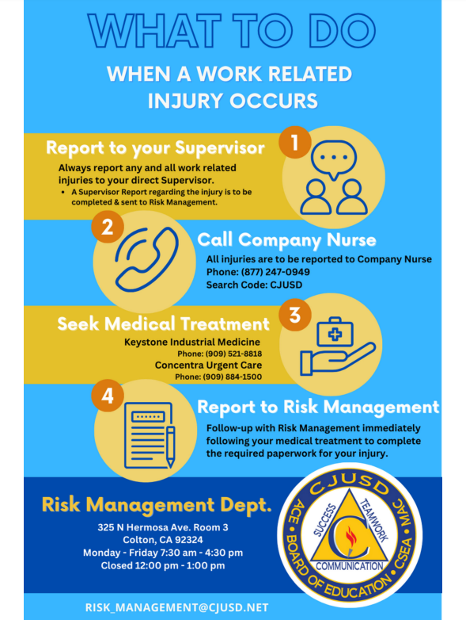
What to do When an Injury Occurs
Step 1 - Call Company Nurse for ALL and ANY Employee injuries
Step 2 - Seek Medical Treatment with 2 options!
Fox Occupational
Keystone Industrial Medicine
Step 3 - Direct Employee to Risk Management to complete the necessary paperwork and discuss the injury process
Step 4 - Complete a Supervisor Report for ALL injuries & return to Risk Management

Slide 6
Medical Status
A medical status email will be sent to the employee’s department/site following every medical appointment
Fully Duty
Modified Duty
Off of Work
Site to determine who will enter missed time.
Front Line – Drop Down: Workers Comp
Notes:
*Explain that it’s important for us to keep track of personal days off and modified duty days – update risk management if employee did not go to work.
*let them know we value all employees. Want to help them get better and back to work
*When employees work at another site, it is a valued added task for the other site. The employee’s help is not only needed but appreciated. The District values our employees.

Slide 7
Full Duty, Modified Duty & Industrial Accident Leave
Full Duty
Modified Duty
Industrial Accident Leave
Employee is able to work to his full capacity per his job description without any need for medical restrictions.
The employee as been given work restrictions per their treating physician. The employee should be able to do a majority of their job or they can do a temporary alternative job, either within their department or another site. They are not required to be at 100% to return to work.
Allowed 60 working calendar days per injury.
The employee has been deemed unable to work per their injury and taken off of work per their treating physician.
Allowed 60 working calendar days per injury.

Slide 8
Return to Work
Modified Duty
Temporary Work Assignment
The employee should be able to do a majority of their job, consistently working within their given work restrictions. It is the employees responsibility to self monitor in order to abide by these restrictions.
An employee can be assigned a temporary alternative job, either within their department or at another site. They are not required to be at 100% to return to work.
Time Tracking is an important aspect during Modified Duty. The department/site should inform Risk Management when an employee elects to use a sick, personal day or vacation time at any time while utilizing their 60 days of Modified Duty.

Slide 9
Benefits to Returning to Work!
Promotes Healing!
Boost of Employee moral!
Meaningful work promotes wellness!
Added value to the Employee!

Slide 10
Liability Forms & Processes

Slide 11
Who Should You Call?
Liability Claims are Alpha Split by between the Risk Specialists by Site Name
(TBD) Sites (A-L) | Jessica's Sites (M-Z)
Alice Birney Elementary | M&O/Warehouse
Bloomington High School | McKinley Elementary
Colton High School | PPS
Colton Middle School | Reche Canyon Elementary
Cooley Ranch Elementary | Rogers Elementary
Crestmore Elementary | Ruth O. Harris Middle School
D'Arcy Elementary | San Salvador Child Development
District Office | Slover Mountain High School
Grand Terrace Elementary | Smith Elementary
Grand Terrace High School | Sycamore Hills Elementary
Grant Elementary | Terrace Hills Middle School
Grimes Elementary | Terrace View Elementary
Hermosa Center | Transportation
Joe Baca Middle School | Washington High School
Jurupa Vista Elementary | Wilson Elementary
Lewis Elementary | Zimmerman Elementary
Lincoln Elementary

Slide 12
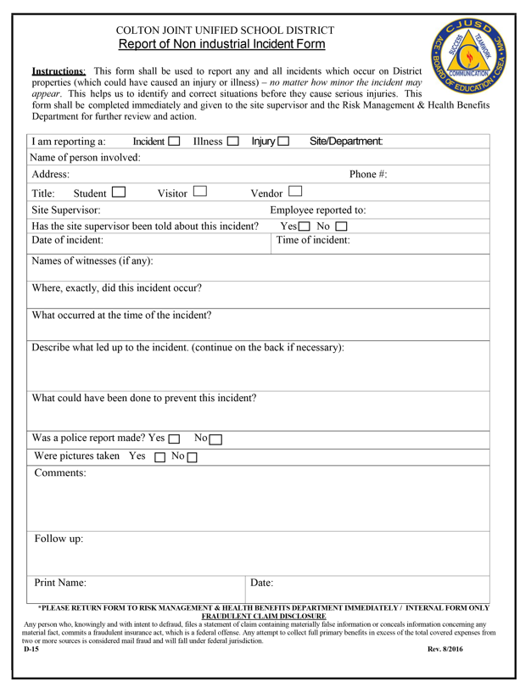
Report of Non-Industrial Incident Form (D-15)
When should I use this?
When any visitor, student or vendor gets injured on our sites.
Who should fill it out?
CJUSD employee who is most knowledgeable of the incident or event.
Steps in reporting and turning in form:
CJUSD employee to complete form
A copy of the completed form should be kept at site. This is an internal form and should not be distributed to any student, parent or visitor.
Turn original copy in to Risk Management via district mail or email to Risk Specialist

Slide 13
Illegal Entry and Damage Report (D-107)
When should I use this?
When District owned equipment have been stolen or damaged.
Who should fill it out?
CJUSD employee who is most knowledgeable of the incident or event.
Steps in reporting and turning in form:
CJUSD employee to complete form
Must list all stolen or damaged items
Work order needed? Should be placed by school site and work order number should be listed on form
CJUSD employee to file a police report
List police report number on form
Copy of the completed form should be kept at site.
Turn original copy in to Risk Management via district mail or email to Risk Specialist

Slide 14
Employee Vehicle Damage Reimbursement Claim (D-136)
When should I use this?
When a CJUSD employee’s personal vehicle is damaged on District property.
Who should fill it out?
The CJUSD employee whose personal car was damaged.
Steps in reporting and turning in form:
Employee must obtain a police report and two estimates for repair
Employee to complete form
Must list police report number
Must be signed by Supervisor
Turn in to Risk Management with two estimates and police report
Will be submitted to Board for approval and maximum reimbursement of $100.00

Slide 15
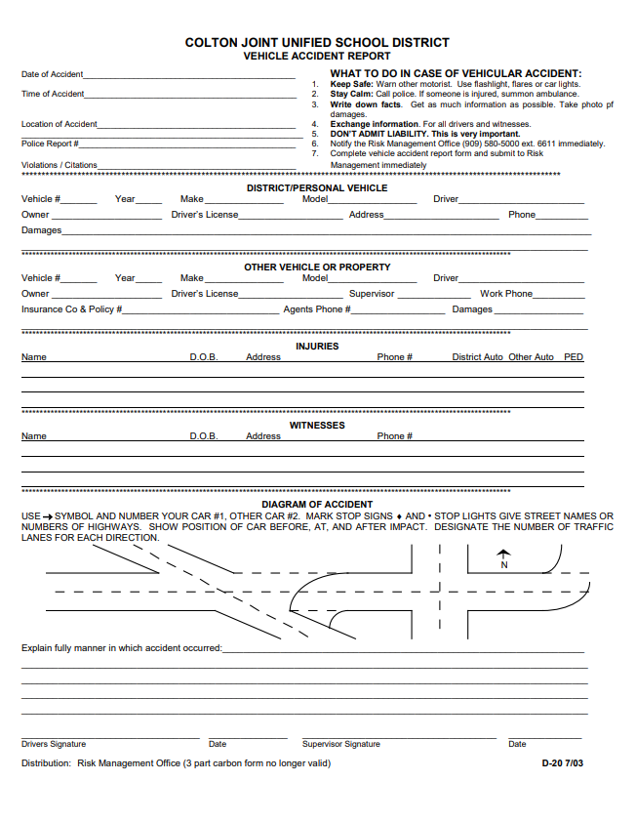
District Vehicle Accident Report (D-20)
When should I use this?
When any auto collisions involving a District vehicle occur.
Who should fill it out?
CJUSD employee that was driving the District vehicle involved in the accident.
Steps in reporting and turning in form:
All District vehicles should have an Auto Accident Kit to reference
Employee is to take pictures and gather other party’s personal information
Name, address, phone number, proof of insurance
Year, make, model of vehicle
Employee must file a police report
Employee should advise other party to contact Risk Management in order to file a claim
Employee to complete form
Supervisor signature is required prior to turning in
Turn in completed form and supporting documents to Risk Management via District mail or email to Risk Specialist

Slide 16
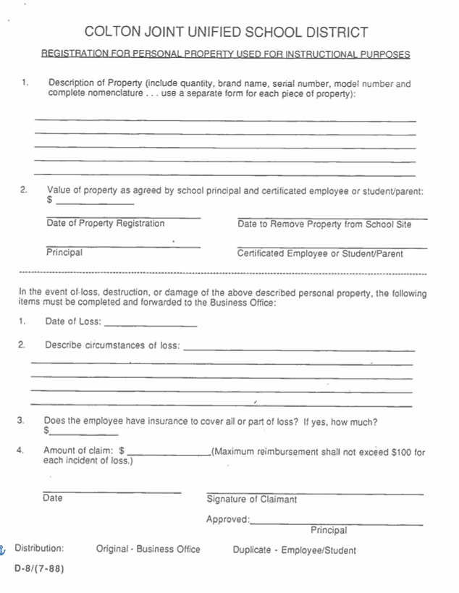
Registration for Personal Property Used for Instructional Purposes (D-8)
When should I use this?
When any personal items for professional use want to be held in classroom/at school site.
Who should fill it out?
The employee making the request.
Steps in reporting and turning in form:
Fill out form completely
Turn form in to Supervisor for approval and housekeeping
Up to site discretion
Stolen or damaged items are up to site to replace/reimburse

Slide 17
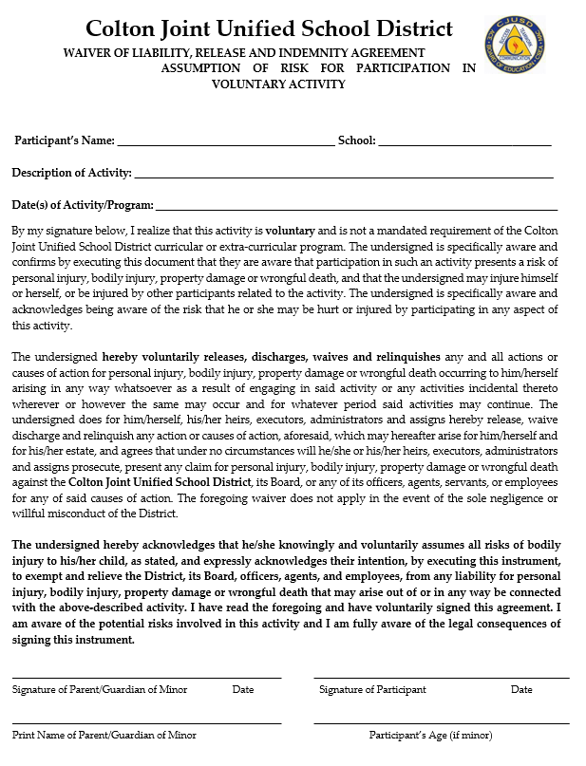
Student & Employee Waiver
When should I use this?
When a student or employee is voluntarily participating in any event.
Who should fill it out?
The student or employee that is participating.
Steps in reporting and turning in form:
Fill out form completely
Students under 18 years of age will need a parent or guardian to sign and agree to waiver terms
Turn in to site or department for housekeeping

Slide 18
All Risk Forms Are Located On:
CJUSD Intranet
Business Services Division → Risk and Benefits → Risk and Safety or Workers Compensation

Slide 19
Questions? Comments?

